Slide 1
Why is Movement Essential to Learning?
This presentation will help staff to understand:
Our inner drive to move, engage and learn from birth
What the sensory and physical systems are
Why they are so important for learning and development

Slide 2
Our Inner Drive to Move, Engage and Learn
Every child is born with an innate motivation to experience the world around them. This is achieved through moving, and receiving sensation .
As they do this, they lay down motor and sensory memory and continuously build on these. This enables engagement and learning.

Slide 3
Our Inner Drive to Move, Engage and Learn
From birth, a baby receives sensory feedback and learns to respond to this.
For example, when a baby is hungry, he or she feels discomfort and learns that crying will illicit a response from the caregiver.
The baby then starts to engage with the world. He or she learns to control basic movements including head control, eye movements and so on.

Slide 4
Our Inner Drive to Move, Engage and Learn
Children move through an expected range of basic large movements, known as milestones, and lay down motor and sensory memories within their central nervous system.
As they grow, they continually build on and integrate previously learnt physical skills, and this enables them to master motor control and the ability to move within environments.

Slide 5
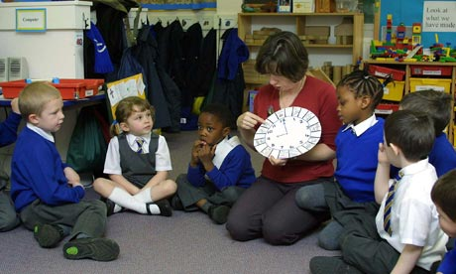
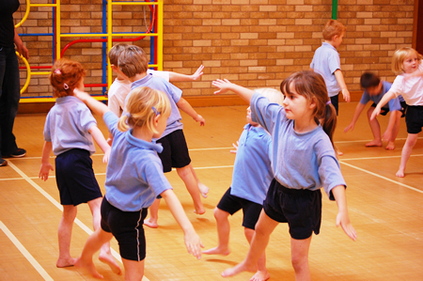
The Importance of Movement and Sensory Experiences in the First 8 Years
Movement and sensory developments form essential building blocks for learning prior to the age of 8.
The most rapid period for this development to take place is within the first 8 years of life. This is when the brain develops the ability to attend and learn.
Yet, in the UK, children enter the statutory education system at 4 years of age which shows how key regular movement is in the early years and KS1 curriculum.
Movement and sensory experiences continue to be key throughout the rest of childhood and into adult life in order for people to be able to function, concentrate and learn at their fullest

Slide 6
The Importance of Sensory and Physical Systems to Learning
Physical and sensory experiences don’t just help children acquire physical and motor skills.
As the following sequence visual shows, the physical and sensory systems are the building blocks for ALL development, not just when young but throughout life.
Therefore, it is essential that we provide young people with the appropriate sensory experiences and movement.
This is a bottom up approach which is often referred to as a sensory pyramid and was produced originally be the sensory integration network.
4. Cognition and intellect
3. Perceptual Motor Skills
2. Sensory motor systems
1. Sensory systems

Slide 7
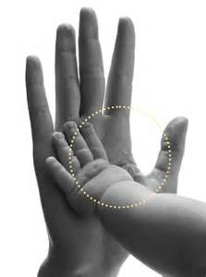
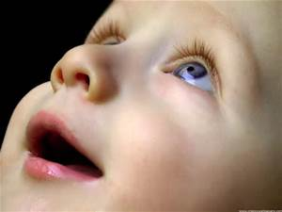
1. What are the Sensory Systems (bottom of pyramid)?
This includes the ability to process from the 5 senses : smell, sight, hearing, touch and taste
Smell
Taste
Hearing
Touch
(protective and discriminative)
Vision

Slide 8
1. What are the Sensory Systems (bottom of pyramid)?
There are 2 more core sensory systems:
Vestibular (Movement) Proprioceptive (Body awareness)
These are core to the development of body awareness, movement and tone.
They are based within the ears and muscles and joints of the body.
Sensation is seen as food for the brain and allows us to lay down motor and emotional memory.
It also helps us be secure in our environment and bodies.

Slide 9
2. What is Sensory Motor Development?
From being able to process information that comes from our sensory systems, sensory motor development occurs. This includes the ability to:
Maintain an “anti gravity” position (e.g. raising an arm from your side to parallel with the floor)
Use both sides of the body in a coordinated manner
Plan new movements and know how to negotiate body movements in relation to the environment. This supports generalisation of skills and motor planning
Have an understanding of our inner body map or our body scheme (e.g. Understanding where your body is in space or what position it is holding at the time)
Inhibit reflexes
Be able to filter out irrelevant or unnecessary sensory information
Develop hand, eye and foot dominance

Slide 10
3. What is Perceptual Motor Development?
Once bodily control is developed, a child will continue to develop the following further skills and abilities:
Control over eye hand movements
Control of eye movement to track objects
To determine the qualities and differences of shapes of objects through experience and the ability to determine differences between these
To complete refined motor movements in relation to moving objects
To coordinate and isolate movement to be able to complete tasks
To develop their attention to a task
Development of language skills
These are all essential for learning and particularly for skills like handwriting.

Slide 11
4. Cognition and Intellect
In order to be able to develop higher cognitive functioning, children need to have moved through all of the previous developments. They will have achieved this through moving and receiving sensation. This higher cognitive functioning includes:
Being able to adapt behaviour in response to sensation, situation and understanding of social contexts
Being able to complete tasks independently, such as dressing, feeding and so on and
Most importantly, in the academic setting, being prepared and able to ATTEND, LEARN and develop INDEPENDENCE SKILLS
(adapted from Taylor and Trott 1991 – sensory pyramid – ‘How does your engine Run?’)
Since movement and sensation are key building blocks for learning and essential to support a range of further developments, it is VITAL that we ensure that pupils of all ages access appropriate movement and sensory activities throughout the school day.

